Slide 1

UMBC Cyber Defense Team
Web Exploitation 2
2016-2017

Slide 2

whoami
Josh
UMBC Alumnus
CyberDawgs Council of Elders (pending approval)
Cutlery Afficianado
Gun Nut
Hacker
Associate Security Analyst at Independent Security Evaluators (ISE)

Slide 3
Today’s Agenda
Recap
Client-Side exploits
Misc.

Slide 4
Recap
Basics
Proxies
Attacks

Slide 5
Unvalidated URL Redirect
Redirection via URL parameters

Slide 6
Testing Methodology
Enumerate the application
Find instances where a URL parameter is used to redirect
Test for arbitrary redirection

Slide 7
How fix?
Prohibit absolute URLs or validate them
Don’t use user-controlled data

Slide 8
HTML Injection/Cross-Site Scripting (XSS)
Injection of arbitrary HTML into a web page
Injection of arbitrary javascript into a page
Can then gain arbitrary command execution in the browser
Different Varieties
Persistent
Reflected

Slide 9
Testing Methodology
Look for areas where user input is then given back to the user
Test those inputs for acceptance of arbitrary HTML characters

Slide 10
How fix?
Input Validation (Server-side; not client-side)
Output Sanitization

Slide 11
Cross-Site Request Forgery (CSRF)
Ability to make unauthorized requests on behalf of sufficiently-authorized users from a different origin
Due to not checking the origin of these requests
Particularly powerful when combined with XSS

Slide 12
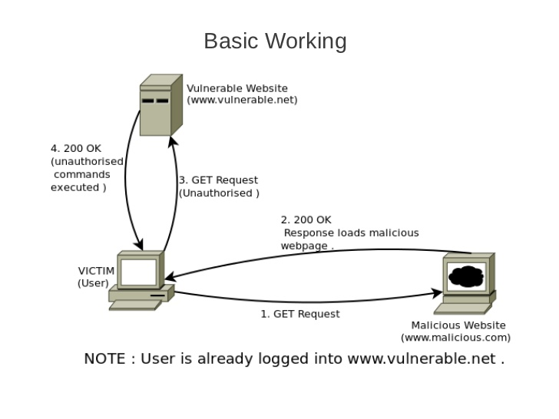
http://image.slidesharecdn.com/csrfbasics-120904001652-phpapp01/95/csrf-basics-4-728.jpg?cb=1346718013

Slide 13
Testing Methodology
Look for requests which lack anti-CSRF tokens
Try changing the referrer header in an HTTP request and see if the request goes through

Slide 14
How fix?
Use of anti-CSRF tokens
Referrer Checking

Slide 15
Putting it All Together
Chaining exploits? Let’s do it
CSRF -> Command Injection
XSS -> Unvalidated URL Redirect -> CSRF -> Command Injection

Slide 16
Thanks!

